Slide 1
Unemployment Compensation
4491-13 Income - Unemployment Compensation v11.0 VO.pptx
Form 1040 Line 19
Pub 17 Chapter 12
Pub 4012 Tab D
Notes:
1

Slide 2
Unemployment Considerations
In TaxWise, enter the information shown on the paper 1099-G
Unemployment compensation is NOT taxable in NJ

Slide 3
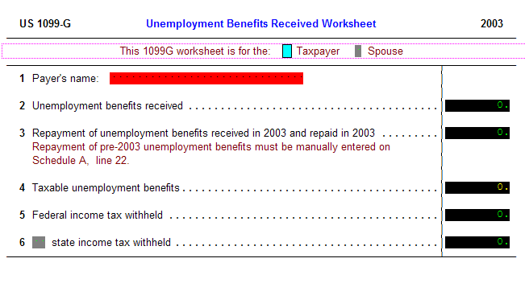
Unemployment Worksheet
2009
2008 and repaid in 2008
pre=-2008
Notes:
3

